Slide 1

Crisis Communications Management
CCM301

Slide 2
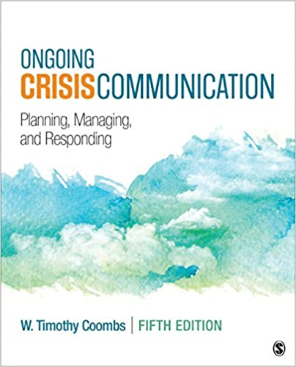
Course Content
The definitions of crisis and how they come about
The importance of the Enterprise Risk Management framework in crisis prevention and preparation
How to recognise and address crises in case they happen
The role of communications throughout the crisis management process
How to utilise media relations and social media to prevent and/or respond to crises
The influence of culture on crisis communication
Case studies

Slide 3
Learning Outcomes
Identify organisational, industrial and environmental challenges and disasters
Demonstrate an understanding of the concepts, theories and practice of issues management and crisis communication.
Analyse and develop strategies for organisational issues using the theories, models and methods of issues management and crisis communication
Gain the capacity to critique organisational and industrial responses to issues and crises
Develop a critical attitude towards crisis communications management
Identify and apply ethical standards of practice when dealing with issues management and crisis communication
Skills in analysis and problem solving; proficient in presentation and teamwork skills.

Slide 4
Assessment Structure
Assessment Category | Weight (%) | Mark to Pass
Class Participation and Preparation | 10 | > 0
Case Study Essay | 15 | > 0
Crisis Group Project | 25 | > 0
Simulated Media Conference | 20 | > 0
Final Exam | 30 | 4
Min Average Mark to Pass: 5

Slide 5

A Need for More Crisis Management Knowledge
CHAPTER 1
Notes:
No organization is immune to crises. If no organization is immune, then all organizations should be prepared. The bottom line is that all organizations should learn as much as they can about crisis management.
The crisis management process is varied and requires the integration of knowledge from such diverse areas as small-group decision-making, media relations, environmental scanning, risk assessment, crisis communication, crisis plan development, evaluation methods, disaster sociology, and reputation management.

Slide 6
Main content
Crisis Management Defined
The Initial Crisis Management Framework
Outline of the Three-Stage Approach
Importance of Crisis Management
Crisis Leadership: An Overlooked Resource

Slide 7
Learning Outcome
LO1: Identify organisational, industrial and environmental challenges and disasters
LO5: Develop a critical attitude towards crisis communications management

Slide 8
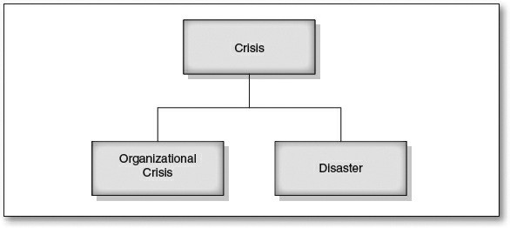
CRISIS MANAGEMENT DEFINED
Crisis: some breakdown in a system that creates shared stress (Perry, 2007).
Figure 1.1 Types of Crises
Notes:
There is no one accepted definition of a crisis. Crisis is a very broad term that is used frequently by practitioners and academics.
Figure 1.1 is a visual representation of how I conceptualize crisis. We can take the general notion of crisis as the starting point, beneath which we have disaster and organizational crisis.

Slide 9
CRISIS MANAGEMENT DEFINED
Disasters:
sudden events
seriously disrupt routines of systems
require new courses of action to cope with the disruption
pose a danger to values and social goals
(Quarantelli, 2005)
large in scale
require response from multiple governmental units
can spawn organizational crises
Notes:
Disasters can spawn organizational crises. For instance, an organization may need to cope with the effects of the disaster on its operation. An example would be utilities needing to restore power to customers following a tornado.
In rarer circumstances a crisis can trigger a disaster. Examples include the Union Carbide toxic gas release in Bhopal, India, and the crude oil spilled into the Gulf of Mexico when the Deepwater Horizon sank.

Slide 10

CRISIS MANAGEMENT DEFINED
Organizational Crisis: the perceived violation of salience stakeholder expectations that can create negative outcomes for stakeholders and/or the organization.
H&M’s crisis in Vietnam (2021)
Source: thanhnien.vn
Notes:
Crises can violate salient expectations that stakeholders hold about how organizations should act. These expectations are important to the stakeholders and can be related to health, safety, environmental, or economic concerns. Planes should land safely, products should not harm us, management should not steal money, and organizations should reflect societal values. Crises disturb some stakeholder expectations, resulting in people becoming upset and angry, which threatens the relationship between the organization and its stakeholders.

Slide 11
CRISIS MANAGEMENT DEFINED
Organizational Crisis:
Perceptual: perceptions of stakeholders help to define an event as a crisis
Unpredictable but not unexpected
Notes:
If stakeholders believe an organization is in crisis, a crisis does exist, and stakeholders will react to the organization as if it is in crisis. Management must be able to see the event from the stakeholders’ perspective to properly assess whether a crisis has occurred.
Crises can be anticipated, but their often sudden nature can give them an element of surprise or unpredictability (Barton, 2001; National Research Council, 1996).

Slide 12
CRISIS MANAGEMENT DEFINED
Organizational Crisis Damage:
Financial loss
Injuries or deaths to stakeholders
Structural or property damage (on and off site)
Tarnishing of a reputation
Damage to a brand
Environmental harm
An entire industry can be affected by a crisis in one of its member organizations

Slide 13

CRISIS MANAGEMENT DEFINED
The difference between incidents and crises illustrates the meaning of serious impact:
Incident: minor, localized disruption
Crisis: serious impact, negative or undesirable outcomes

Slide 14
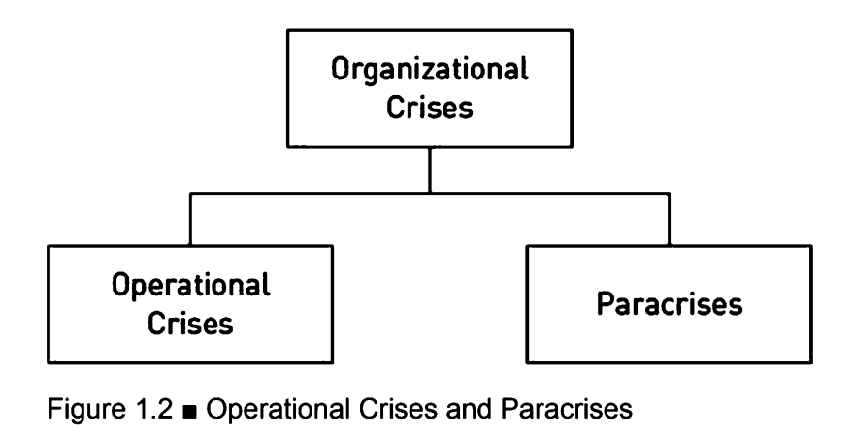
CRISIS MANAGEMENT DEFINED
Organizational Crisis:

Slide 15
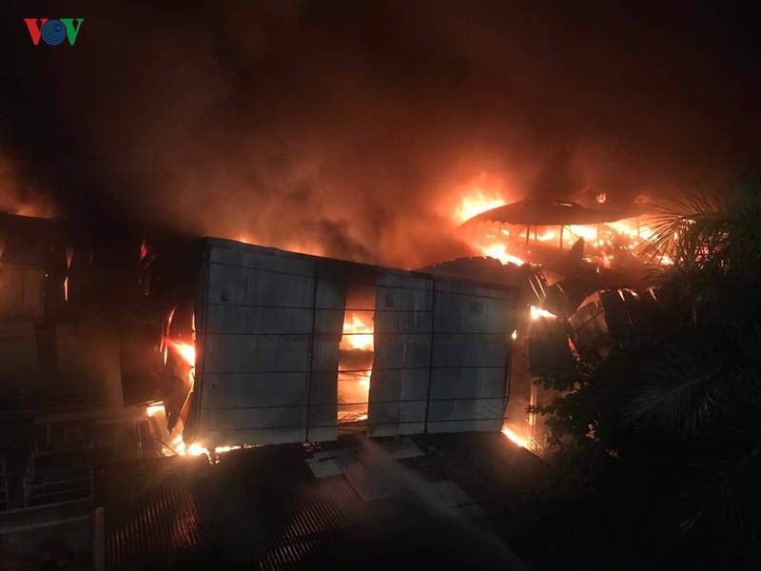
CRISIS MANAGEMENT DEFINED
Operational crises:
There is actual or potential disruption to organizational operations
Crisis managers must consider various stakeholders’ information needs when there are disruptions
Rang Dong warehouse fire (2019)
Source: vov.vn
Notes:
Operational crises reflect the roots of crisis management itself. One potential effect from a crisis is to disrupt operations either completely or partially. Many early definitions of crisis include disruption of operations (e.g., Barton, 2001).
Facility fires, natural disasters, and product harm situations are all examples of operational crises.

Slide 16
CRISIS MANAGEMENT DEFINED
Paracrises:
Situations where crisis managers must manage a crisis risk in full view of its stakeholders
Specific type of crisis warning sign
Resemble a crisis: threaten the organization’s reputation and related assets
Not require the activation of the crisis team
Not disrupt the organization
Warrants attention: neglect or mismanagement could escalate into an operational crisis
Notes:
All crises will inflict some reputational damage on an organization. However, certain situations are primarily reputational and have limited effects on operations.
The term “para” means resembling or protection from something.
Example (ebook, p.21):
In 2008, Motrin created an edgy ad that noted how mothers have back pain from using sling-type baby carriers. The ad was in print and Online in video form. Many mothers were offended by it and took to social media to express their outrage. Twitter was a popular location for mothers to attack Motrin. There was even a nine-minute YouTube video featuring the Twitter complaints. The ad appeared online on a Saturday morning. The social media criticism stormed Twitter by Saturday evening. On the following Monday, McNeil Consumer Healthcare, the maker of Motrin, removed the ad from the Internet and replaced it with an apology (Tsouderos, 2008).
McNeil Consumer Healthcare did not see any disruption in the production or sale of Motrin. There was minor damage to the corporate and product reputation that had the potential to escalate if the paracrisis was not handled swiftly and effectively. By removing the ad and apologizing, McNeil Consumer Healthcare managed the paracrisis, thereby defusing a potential crisis.

Slide 17

CRISIS MANAGEMENT DEFINED
Paracrises:
Visibility gives a paracrisis its impact
Blur the line between precrisis and crisis response
Coca-Cola’s paracrisis (2019)
Source: thanhnien.vn
Notes:
https://nld.com.vn/van-nghe/coca-cola-bi-bo-vh-tt-dl-tuyt-coi-vi-quang-cao-thieu-tham-my-20190628220220977.htm
https://nld.com.vn/kinh-te/coca-cola-dung-quang-cao-dong-chu-mo-lon-viet-nam-20190629142203035.htm
Paracrises that emerge in digital communication channels and platforms such as social media are unique crisis warning signs because they appear in full view of stakeholders. Typically, crisis prevention efforts are invisible to stakeholders => Visibility is what gives a paracrisis its impact.
The public appearance of the paracrisis demands public management. Managers must explain to all stakeholders what is being done to address the concern or why they are choosing to ignore it.
The paracrisis blurs the line between precrisis and crisis response because addressing the paracrisis can appear to be a crisis response rather than preventative action. The key point here is that the digital communication channels and platforms increase the visibility and number of paracrises because the Internet can highlight the stakeholder concerns that drive paracrises.

Slide 18
Discussion
1. Do you agree or disagree with the idea that a crisis is perceptual?
2. What do you think makes an event a crisis? How do crises differ from disasters?
3. Why bother differentiating between crises and paracrises?

Slide 19
CRISIS MANAGEMENT DEFINED
Crisis Management: a set of factors designed to
combat crises
prevent or lessen the negative outcomes of a crisis/ actual damage inflicted
protect the organization, stakeholders, and industry from harm

Slide 20
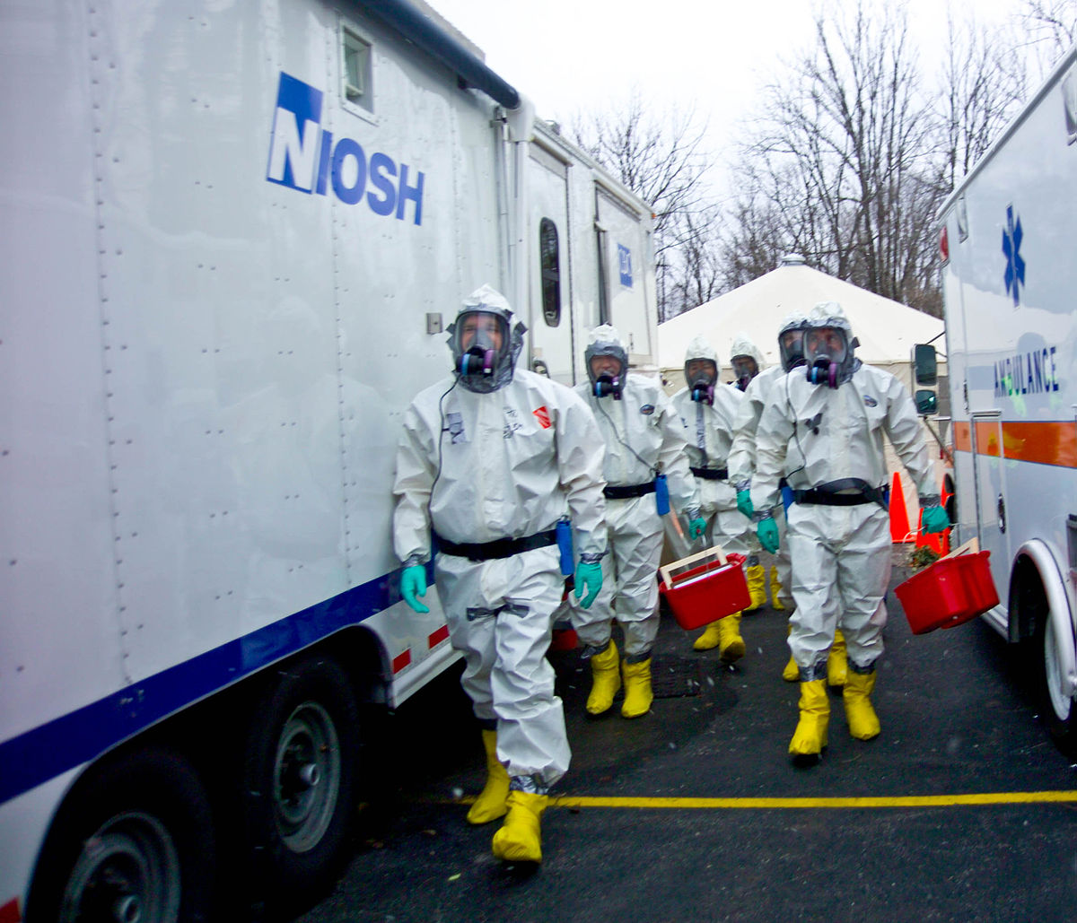
CRISIS MANAGEMENT DEFINED
Crisis Management’s Factors:
Prevention
Preparation
Response
Revision
This Photo by Unknown Author is licensed under CC BY-SA

Slide 21
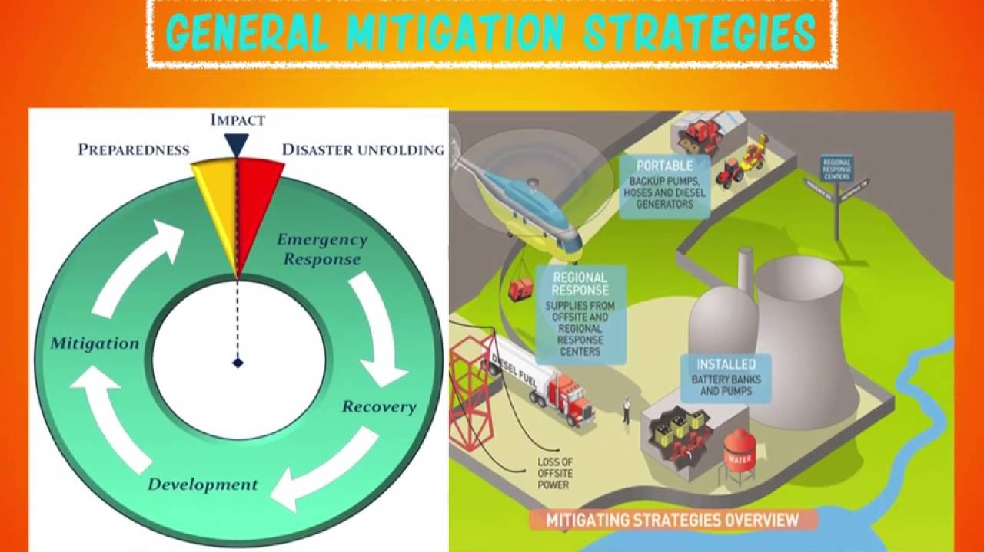
CRISIS MANAGEMENT DEFINED
Prevention (Mitigation):
Steps taken to avoid crises
Crisis managers:
detect warning signs
take actions designed to prevent the crisis
largely unseen by the public

Slide 22
CRISIS MANAGEMENT DEFINED
Preparation:
Preparing the crisis communication plan (CCP)
Diagnosing crisis vulnerabilities
Selecting and training a crisis management team and spokespersons
Creating a crisis portfolio
Refining a crisis communication system
Notes:
Preparation is the best-known factor in crisis management because it includes the crisis communication plan (CCP). If people know nothing else about crisis management, they know an organization should have a CCP. The CCP is the tip of the crisis management iceberg. Although people think the CCP is the crisis management process, in actuality, most of the process is unseen.

Slide 23
CRISIS MANAGEMENT DEFINED
Response:
Application of the preparation components to a simulated or real crisis
Running simulated crises and drills: determine the fitness of the preparation components:
CCP
Crisis team members
Spokespersons
Communication system

Slide 24
CRISIS MANAGEMENT DEFINED
Responses in an actual crisis:
The execution of the same crisis management resources with the real outcomes
Very public: frequently reported and critiqued in the news media
Seek to achieve outcomes related to reducing the negative impact of a crisis on stakeholders and the organization or even leading to an improved organization
Recovery: the organization’s attempts to return to normal operations as soon as possible following a crisis
Notes:
Crises make for good news stories.
Organizations try to limit the threat to public safety, reputational erosion, brand damage, and loss of sales, to name but a few of the common crisis communication objectives.
There is even a chance that the response leads to an improved organization. Improvements can include a stronger reputation, a more powerful brand, and changes to the organization that make it a safer place to work. Part of the response is recovery, which denotes the organization’s attempts to return to normal operations as soon as possible following a crisis. Business continuity is the name used to cover the efforts to restore operations to normal. As noted earlier, downtime from a crisis is a financial drain. The quicker an organization can return to normal operations, the fewer financial losses it will incur.

Slide 25
CRISIS MANAGEMENT DEFINED
Revision:
Evaluating the organization’s response
Revising the organization’s prevention, preparation, and response efforts
Expanding the organization’s perception of crises and its response capacity
➔ Improve the effectiveness of crisis management
Notes:
Revision involves evaluation of the organization’s response in simulated and real crises, determining what it did right and what it did wrong during its crisis management performance.
The organization uses this insight to revise its prevention, preparation, and response efforts. Ideally, in the future, the right moves are replayed while the mistakes are avoided and replaced by more appropriate actions.
Revision is the development of an institutional or organizational memory, which can improve the effectiveness of crisis management by expanding the organization’s perception of crises and its response capacity. The more and varied the crises an organization experiences through practice sessions, the better it can handle similar situations in reality.

Slide 26
THE INITIAL CRISIS MANAGEMENT FRAMEWORK
Crisis management: appropriately viewed as an ongoing process
Crisis life cycle: “staged approaches” to crisis management
The crisis management function is divided into discrete segments that are executed in a specific order
Notes:
Effective crisis management must be integrated into the normal operations of an organization
Crisis management is not merely developing a plan and executing it during a crisis. Instead, it is appropriately viewed as an ongoing process.

Slide 27
THE INITIAL CRISIS MANAGEMENT FRAMEWORK
Past Staged Approaches to Crisis Management:
Fink’s four-stage model (1986)
Mitroff’s five-stage model (1994)
Basic three-stage model

Slide 28
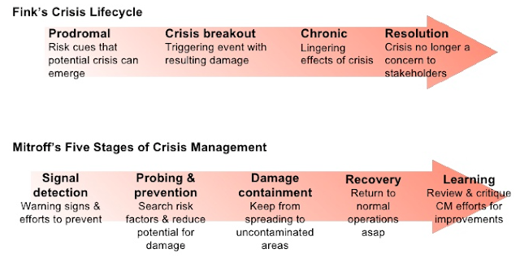
THE INITIAL CRISIS MANAGEMENT FRAMEWORK
Notes:
Fink uses a medical illness metaphor to identify four stages in the crisis life cycle:
(1) Prodromal: clues or hints of a potential crisis begin to emerge;
(2) Crisis breakout or acute: a triggering event occurs along with the attendant damage;
(3) Chronic: the effects of the crisis linger as efforts to clean up the crisis progress;
(4) resolution: there is some clear signal that the crisis is no longer a concern to stakeholders—it is over.
lan Mitroff (1994) divides crisis management into five phases:
signal detection: new crisis warning signs should be identified and acted upon to prevent a crisis;
probing and prevention: organization members search known crisis risk factors and work to reduce their potential for harm;
damage containment: a crisis hits and organization members try to prevent the damage from spreading into uncontaminated parts of the organization or its environment;
recovery: organization members work to return to normal business operations as soon as possible;
learning: organization members review and critique their crisis management efforts, thereby adding to the organization’s memory.

Slide 29
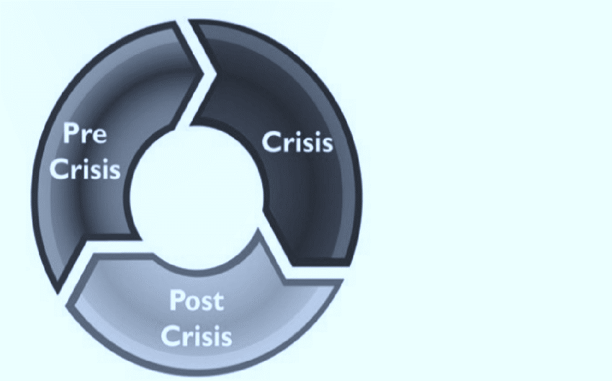
THE INITIAL CRISIS MANAGEMENT FRAMEWORK
Basic three-stage model:
(1) Precrisis/predisaster phase
(2) Crisis impact/rescue phase
(3) Recovery/demise phase
(Richardson, 1994)
Notes:
The three-stage model has no clearly identifiable creator but has been recommended by a variety of crisis management experts (e.g., Birch, 1994; Guth, 1995; Mitchell, 1986; Seeger, Sellnow, & Ulmer, 2003). However, Richardson (1994) provides the first detailed discussion of its components:
precrisis or predisaster phase: warning signs appear and people try to eliminate the risk;
crisis impact or rescue phase: the crisis hits and support is provided for those involved in it;
recovery or demise phase: stakeholder confidence is restored.

Slide 30
THE INITIAL CRISIS MANAGEMENT FRAMEWORK
Fink | Mitroff | Three-stage
Prodromal | Signal detection | Pre crisis
 | Probing and prevention
Crisis breakout | Damage containment | Crisis
Chronic | Recovery
Resolution | Learning | Post crisis
Comparison of Staged Approaches to Crisis Management

Slide 31
THE THREE-STAGE APPROACH
PRECRISIS:
Involves 3 substages:
(1) signal detection
(2) prevention
(3) crisis preparation
Organization members must
be proactive: take all possible actions to prevent crises
prepare for crises as well
Notes:
Signal detection: Most crises do emit early warning signs. If early action is taken, these crises can be avoided (Gonzalez-Herrero & Pratt, 1995). Crisis managers must identify sources for warning signs, collect information related to them, and analyze the information. Crisis managers must develop a system for detecting potential crises and responding to them.
Crisis prevention: Once the potential is detected, actions must be taken to prevent the crisis. Preventative measures fall into three categories: issues management, risk management, and reputation management. Issues management means taking steps to prevent a problem from maturing into a crisis. Risk management eliminates or lowers risk levels. Reputation management seeks to resolve problems in the stakeholder-organization relationship that could escalate and damage the company’s reputation.
Crisis preparation: Crisis managers must be prepared for a crisis happening. Preparation typically involves identifying crisis vulnerabilities, creating crisis teams, selecting spokespersons, drafting CCPs, developing crisis portfolios (a list of the most likely crises to befall an organization), and structuring the crisis communication system.

Slide 32
THE THREE-STAGE APPROACH
CRISIS:
Begins with a trigger event
Crisis managers must
realize that the organization is in crisis
take appropriate actions
Ends when the crisis is considered to be resolved

Slide 33
THE THREE-STAGE APPROACH
2 substages
(1) crisis recognition
(2) crisis containment
CRISIS:
Communication with stakeholders (through the organization’s words and actions) is critical
Notes:
Crisis recognition: People in an organization must realize that a crisis exists and respond to the event as a crisis. Crisis recognition includes an understanding of how events get labeled and accepted as crises—how to sell a crisis to management—and the means for collecting crisis-related information.
Crisis response: Crisis containment focuses on the organization’s crisis response, including the importance and content of the initial response, communication’s relationship to reputational management, contingency plans, and follow-up concerns.

Slide 34
THE THREE-STAGE APPROACH
POSTCRISIS:
Postcrisis actions help to
make the organization better prepared for the next crisis
make sure stakeholders are left with a positive impression of the organization’s crisis management efforts
check to make sure that the crisis is truly over
Notes:
When a crisis is resolved and deemed to be over, an organization must consider what to do next.
Evaluating crisis management, learning from the crisis, and other postcrisis actions, such as follow-up communication with stakeholders and continued monitoring of issues related to the crisis.

Slide 35
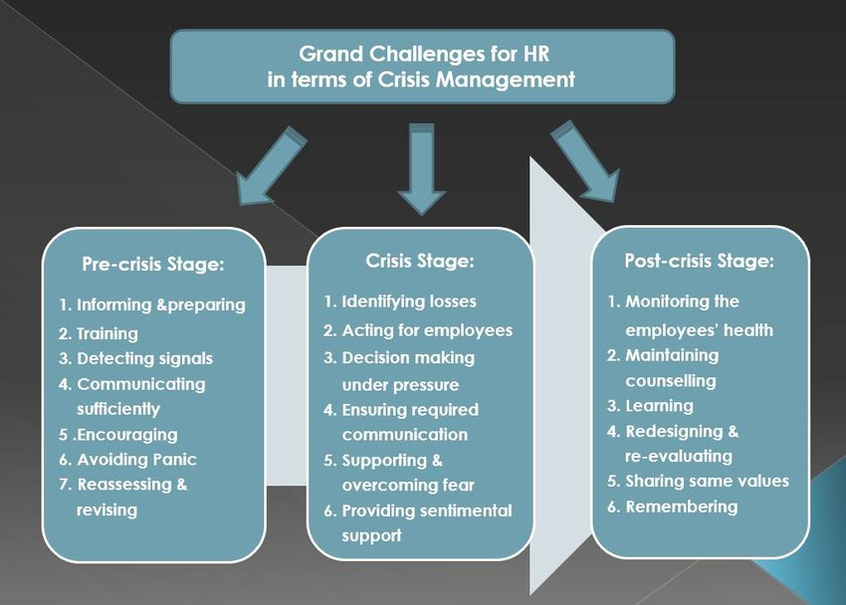


Slide 36
Discussion
Some people question the value of precrisis activities. What reasons do you see that argue for and against precrisis activities?

Slide 37
IMPORTANCE OF CRISIS MANAGEMENT
Crises are ubiquitous: all types of organizations are more susceptible to crises
Higher premiums on crisis management: unprepared organizations have more to lose today than ever before
Notes:
In fact, today’s environment seems to be placing higher premiums on crisis management; unprepared organizations have more to lose today than ever before. A variety of developments has made all types of organizations more susceptible to crises.

Slide 38
IMPORTANCE OF CRISIS MANAGEMENT
Common negative effects from crises:
decrease in revenue
cutbacks and/or layoffs
loss of corporate reputation
increased media scrutiny
increased government scrutiny
decreased share price
increased social media discussions

Slide 39
IMPORTANCE OF CRISIS MANAGEMENT
The developments that increase the need for effective crisis management:
increased value of reputation
stakeholder activism through communication technologies
broader views of crises
negligent failure to plan

Slide 40
IMPORTANCE OF CRISIS MANAGEMENT
Value of Reputations
Reputation: extremely valuable intangible organizational resource
Favorable reputations:
attract customers
generate investment interest
attract top employee talent
motivate workers
increase job satisfaction
generate more positive media coverage
garner positive comments from financial analysts

Slide 41
IMPORTANCE OF CRISIS MANAGEMENT
Value of Reputations
A reputation is built through the direct and indirect experiences stakeholders have with the organization
Positive interactions and information about the organization build favorable reputations
Unpleasant interactions and negative information lead to unfavorable reputations
A crisis poses a threat to reputational assets
Notes:
As greater emphasis is placed on reputation, a corresponding emphasis must be placed on crisis management as a means of protecting reputational assets (Coombs & Holladay, 2002).

Slide 42
IMPORTANCE OF CRISIS MANAGEMENT
Stakeholder Activism
Angry stakeholders are more likely to generate crises
Internet provides various means of stakeholder expression
Key feature: users’ ability to create the content rather than just the organizations
Social media: Internet platforms where stakeholders create the content
Notes:
Consumers, shareholders, employees, community groups, and activists are becoming increasingly vocal when dealing with organizations and are using the Internet to voice those concerns (Coombs, 2002; Heath, 1998). The Internet provides various means of stakeholder expression, including web pages, discussion boards, blogs, microblogs, social networks, and content-sharing sites.

Slide 43
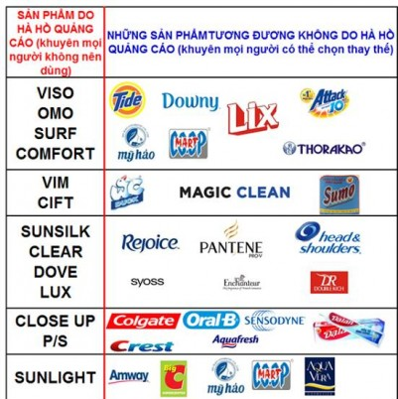
IMPORTANCE OF CRISIS MANAGEMENT
Stakeholder Activism
Crisis can occur when disgruntled stakeholders strike a responsive chord and connect with other stakeholders online
Legitimate criticism spreading among stakeholders poses a direct threat to the organization’s reputation
Brands Boycott following Ho Ngoc Ha’s scandal (2016)
Source: petrotimes.vn
Notes:
The vast majority of social media messages never find an audience. However, when disgruntled stakeholders strike a responsive chord and connect with other stakeholders online, a crisis can occur. These crises evolve from the value of the organizational reputation.
https://petrotimes.vn/nhung-nhan-hang-tay-chay-ho-ngoc-ha-387511.html

Slide 44

IMPORTANCE OF CRISIS MANAGEMENT
Stakeholder Activism
Activist groups use the Internet to organize and to pressure organizations to change their behaviors
Internet: increase the power of activist groups
make them audible to managers
put them on an organization’s agenda for consideration
Greenpeace’s campaign against KitKat (2010)
Source: Greenpeace International’s Flickr
Notes:
Social media is part of a mix of pressure tactics, along with negative publicity campaigns and boycotts.
Classic Casestudy: http://edition.cnn.com/2010/WORLD/asiapcf/03/19/indonesia.rainforests.orangutan.nestle/index.html
https://www.brandsvietnam.com/congdong/topic/403-Ideas-Rendezvous-14-Dung-chet-vi-thieu-hieu-biet-mang-xa-hoi-Khung-hoang-tu-KitKat

Slide 45
IMPORTANCE OF CRISIS MANAGEMENT
Digital Naturals
Have the skills and motivation to use digital communication channels and platforms such as social media
Use digital channels and platforms to make the world more visible to others
Instrumental to the earlier notion of stakeholder activism
➔ As stakeholders are increasingly digital naturals, crisis managers must integrate digital communication channels and platforms into the entire crisis management process.
Notes:
In earlier versions of this book, this point was called communication technologies. However, it was a mistake to focus on the technology and not the people using the technology.
Young and Akerstrém (2016) define digital naturals as “individuals who are comfortable in the online environment, being equipped through experience and exposure to both its cultural norms and the technological competencies required to operate effectively” (p. 1).
Digital naturals are instrumental to the earlier notion of stakeholder activism. Most large activist organizations will be skilled in the use of digital channels and platforms. Digital naturals use digital channels and platforms to make the world more visible to others. Events that might have gone unnoticed decades ago are now visible to others.
There is potential for any crisis or paracrisis to go global. Potential is a keyword. Crises and paracrises are now more likely to be seen by the world thanks to advances in communication technologies.

Slide 46
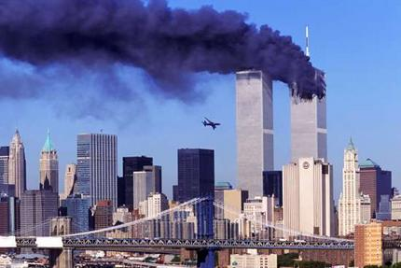
IMPORTANCE OF CRISIS MANAGEMENT
Broader View of Crises
Before Sep-11 event: crisis management was driven by what might happen to organizations on their sites
After Sep-11 event: organizations are broadening their view of crises:
include nearby facilities that could create crises for them
increase emphasis on security and emergency preparedness
This Photo by Unknown Author is licensed under CC BY-NC-ND

Slide 47
IMPORTANCE OF CRISIS MANAGEMENT
Broader View of Crises
Social media: add another layer to broadening the view of crises
Crisis threats (especially those that damage reputations) can emerge and grow rapidly online
Burson-Marsteller and Penn Schoen Berland’s study: 55% of managers felt social media had increased their vulnerability to crises
➔ Increasing need to monitor social media and to decide how to integrate it into the crisis response

Slide 48
IMPORTANCE OF CRISIS MANAGEMENT
Negligent Failure to Plan
Negligent organizations: not take reasonable action to reduce or eliminate known or reasonably foreseeable risks that could result in harm
Crisis prevention and preparation: defenses against this liability
Crisis management: a form of due diligence (efforts to avoid harm to others or to the organization)
workplace violence
industrial accidents
product tampering
terrorist attacks
Notes:
Organizations can be found legally liable if they did not take precautions to prevent potential crises and were not prepared to respond. This new area of liability is known as negligent failure to plan and is closely tied to crisis management.
Both crisis prevention and crisis preparation serve as defenses against negligent failure to plan. Crisis management is becoming firmly established as a form of due diligence (efforts to avoid harm to others or to the organization) that will protect an organization not only from the immediate harm of a crisis but from secondary harm resulting from lawsuits.

Slide 49
CRISIS LEADERSHIP: AN OVERLOOKED RESOURCE
Leadership:
a process whereby an individual influences a group of individuals to achieve a common goal
often overlooked in discussions of crisis management and crisis communication
can have a major impact on the effectiveness of the crisis management effort during a crisis

Slide 50
CRISIS LEADERSHIP: AN OVERLOOKED RESOURCE
Crisis leadership:
Unique because the leaders are
being watched by stakeholders (in public view)
under pressure to utilize shortcuts that will make the crisis disappear but could be ineffective in the long run
Good crisis leaders: willing to learn, open to new ideas, and believe the organization will emerge stronger after the crisis

Slide 51
Conclusion
The need for crisis management is increasing. The value of crisis management is greater now
Crisis management acts as a hedge against the negative outcomes of crises
Today’s operating environment demands that organizations be prepared to manage crises

Slide 52
Conclusion
We experience crises through the news media and the Internet.
What the public sees of the response to a crisis is a small part of crisis management. Effective crisis management is ongoing.
Crisis managers carefully dissect each crisis in order to improve prevention, preparation, and response.
An appreciation of the phases of crisis management helps people better appreciate the complexity and ongoing nature of crisis management and communication.

Slide 53
Discussion
What are some arguments managers would use against implementing a crisis management system?

Slide 54
Individual Assessment (At home)
CASE STUDY ESSAY
Topic: Choose from the list of crisis case studies provided by the lecturer, or select your own (approved by your lecturer), and analyse an organisational crisis.
Type: Essay
Weight: 15%
Length: 2,000 words

Slide 55
Individual Assessment (At home)
Instruction
Task
Your essay will include an overview of the crisis, a description of the organisation, a crisis timeline, actions and responses taken, a media analysis, stakeholder impacts, lessons learned, recommendations, and use appropriate matrix/models.
The essay should address the criteria as outlined in the assessment task and rubric mentioned during the class.
Studens should use a mix of scholarly references, media coverage and organisational materials.

Slide 56
Next chapter
Chapter 2
RISK AS THE FOUNDATION FOR CRISIS MANAGEMENT AND CRISIS COMMUNICATION

Slide 57


